Slide 1

Adding dependency trees to the Taiwan Mandarin corpus texts

Slide 2
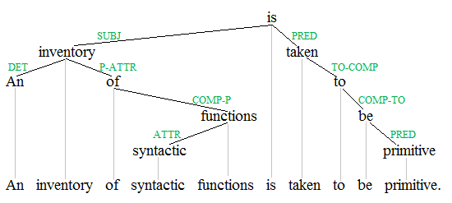
Dependency trees
In its fullest form, it shows the relationships between any two words inside a sentence
In practice, we will do something a little simpler …

Slide 3
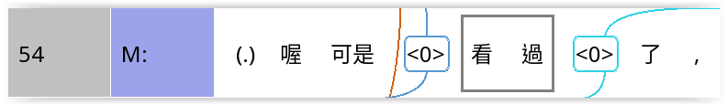
For this project
We will just draw relationships between verbs and subjects (S or A)
For example:
We need to draw the relationship between 看過 and the first <0>

Slide 4
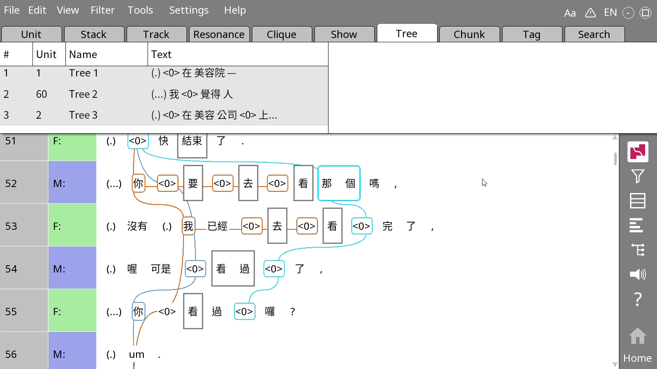
Starting a tree
Right-click the line number or speaker label of the relevant line
Click on Tree from unit

Slide 5
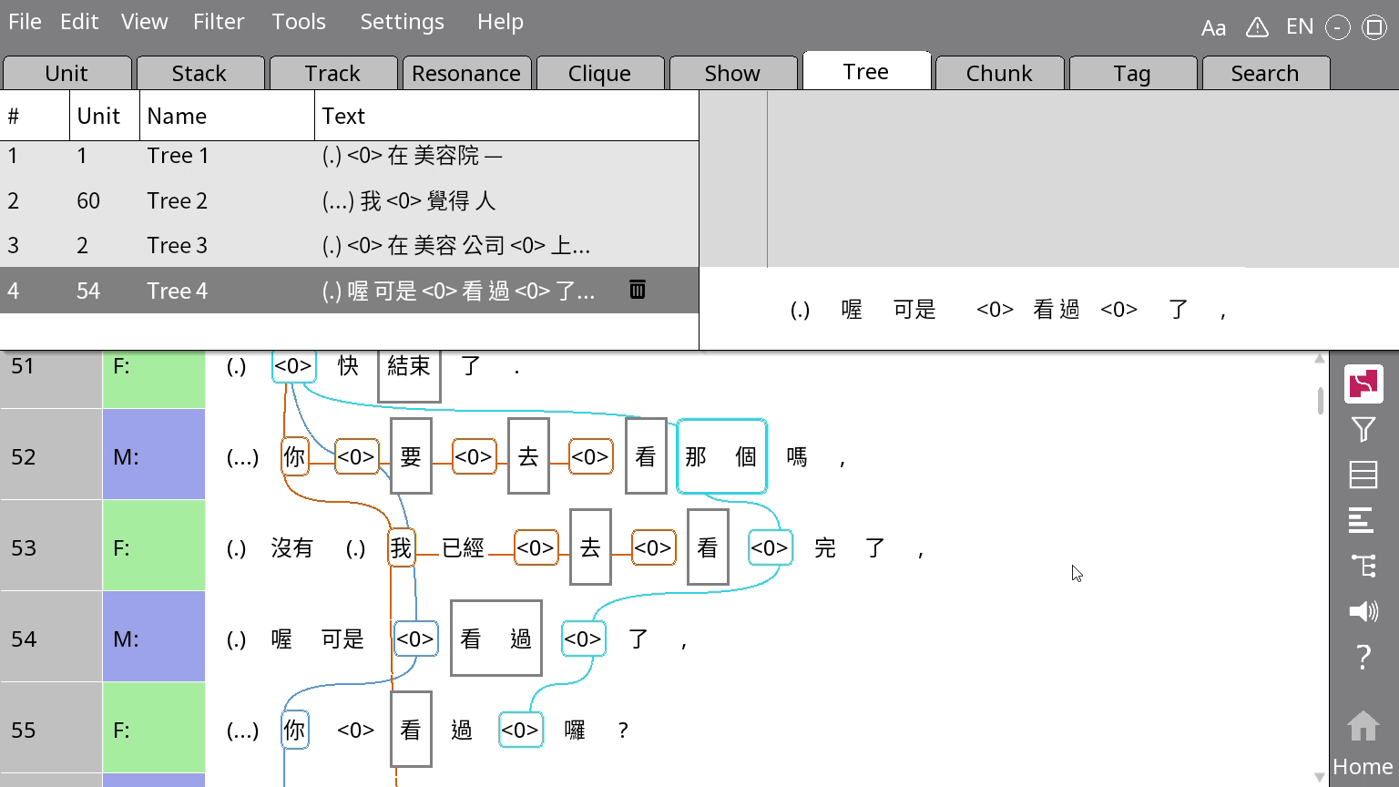
Drawing the tree
Important! If either the subject or the verb has more than one word, drag your cursor across the two words in the bottom white bar of the right side of the Tree pane to combine them.
Click on the verb first, then click on the subject to link it to the verb.

Slide 6
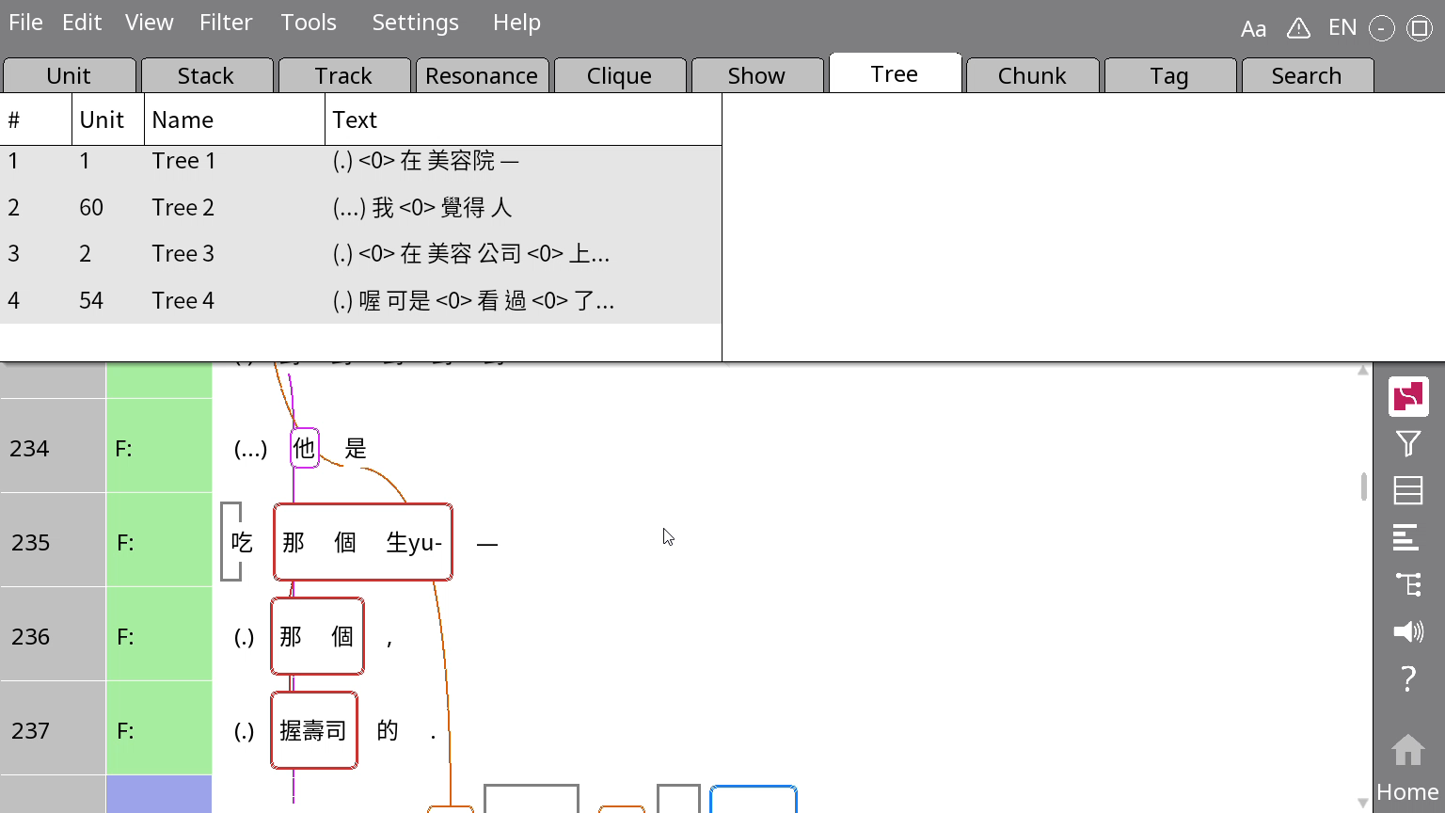
What if the noun and the verb are in two different lines?
Drag your mouse across the line number or speaker label of the lines involved
Right-click the line number or speaker label, choose Tree from stack (not Tree from unit)

Slide 7
This is a good time to double-check everything!
Mistakes after this point will be messy to fix …

